Slide 1
The 4th Family Medicine Review Course

Slide 2
Audiograms & Tympanogram
Dr Fareedah Alkandery
R3 Family medicine Resident

Slide 3
Interpretation
is a graph that shows the softest sounds a person can hear at different frequencies
First line investigation that
is done when patient complains
of hearing difficulties.
O – air conduction
X – air conduction
> - bone conduction
< - bone conduction
L R
A
B
O
X
<
>

Slide 4
Above 20dB = normal

Slide 5
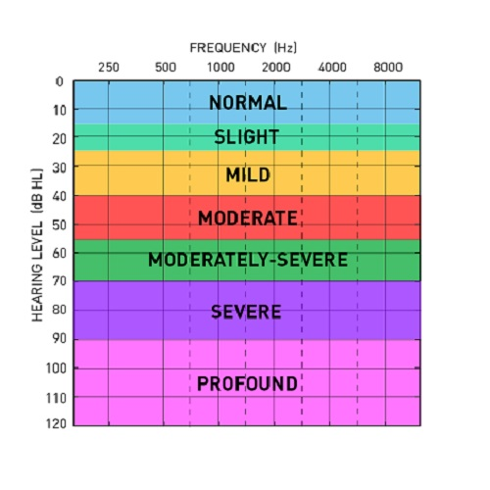

Slide 6
TYPE
O
X
<
>
SENSORINEURAL HEARING LOSS
(Both air and bone conduction impaired)
CONDUCTIVE HEARING LOSS
(only air conduction impaired)
MIXED HEARINH LOSS
(both air and bone conduction impaired but air is worse)
O
X
O
X
<
>

Slide 7
Notes:
NORMAL

Slide 8
Bilateral sensorineural

Slide 9
Left mixed hearing loss

Slide 10
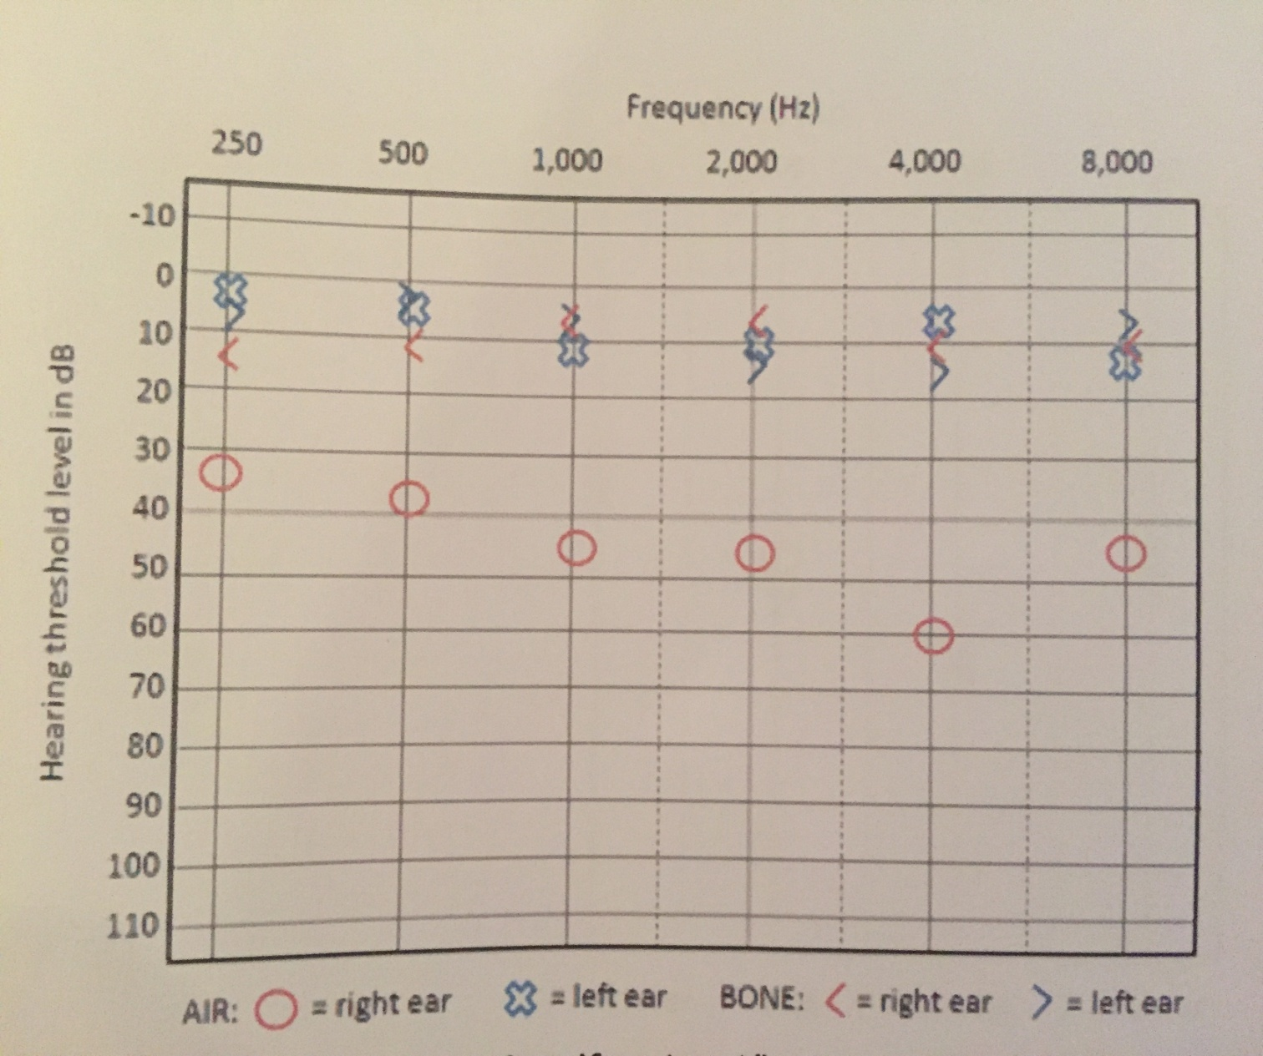
Right conductive hearing loss

Slide 11
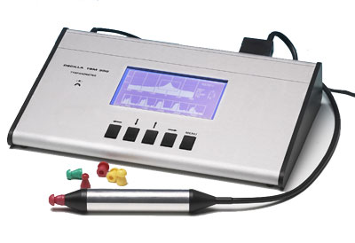
Tympanogram
Shape of curve
Type A (NORMAL) has middle peak
Type B (ABNORMAL) flat line
Ear canal volume
can vary and are age dependent, but typically range from 0.3mL to 0.9mL

Slide 12
TYPE A
NORMAL

Slide 13
Volume high = perforation
Volume normal = fluid

